Slide 1


Glen Dimplex Ethical Sourcing - What is Sedex?
It’s all about ESG – Environment, Social & Governance and responsible sourcing
A not-for-profit organisation that aims to improve ethical and responsible business practices in global supply chains
Stands for: Supplier Ethical Data Exchange
An online system/database that allows suppliers to maintain data on ethical & responsible practices and allows them to share this information with their customers
Helps businesses to gain visibility into their supply chain, manage risks, and report to stakeholders with the Sedex platform
Sedex Radar tool helps businesses identify and compare supply chain risks globally
Protect your reputation and brand by proactively managing supply chain risk.
Increase efficiencies by accessing supplier data already on the platform
74,000 members

Slide 2
Glen Dimplex Ethical Sourcing
Background
The Glen Dimplex Group Sustainability Report launched in July 2022 states that we will:
consider Environmental, Social and Governance (ESG) issues in all our decisions. All of this needs to be underpinned by robust policies and ways of working.
ensure zero modern slavery in our supply chain
Increasing number of queries from customers globally regarding the Glen Dimplex approach to ESG
Procurement has responsibility for ensuring Ethical Sourcing
Policies
Group Ethical Sourcing Policy
Glen Dimplex Code of Business Ethics and Conduct
All Procurement staff to read and be familiar with the Policy & Code
should be part of employee induction with training records maintained
Roles & Responsibility
Site level policies and procedures to be maintained
Local responsibility assigned
Co-ordination with Group Procurement and GDHK as required
e.g. working with GDHK on supplier set up and maintenance of records such as audits and signed versions of the Code of Business Ethics and Conduct
Role of GDHK
Supplier Set-up Questionnaires
Ensuring suppliers sign the GD Code of Business Ethics and Conduct
SMETA Audits performed by GDHK Staff

Slide 3
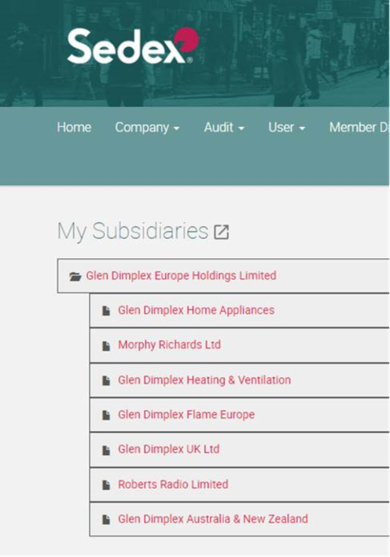
Glen Dimplex Ethical Sourcing
Sedex Membership
All business units have been set up with Sedex membership
Subsidiaries of Glen Dimplex Europe Holdings
Individuals will have access to the Sedex on-line platform
Access to Sedex account manager to assist in the use of the online platform
Sedex on-line platform tools
Supply Chain Mapping & Risk Radar
Tools to be used by individual businesses to asses risks in the supply base
Suppliers to be requested to join Sedex
Supply Base continually monitored for risks
Audit results can be reviewed through Sedex platform

